Slide 1
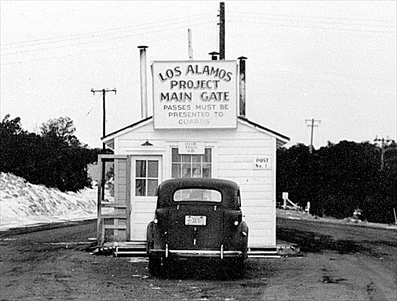
How LANL Does It

Slide 2
Introduction
Overview
Account Management
File Systems
Resource Management

Slide 3
Overview

Slide 4
Overview
Tiered security separates network types
Turquoise Network accessible from outside through gateway node once logged into gateway access to clusters is through head nodes
Yellow Network accessible from other yellow machines accessible from outside through 'ssl-portal'
Red Network air-gapped from outside; not accessible

Slide 5
Overview
Usage Model - Front Ends
Do
Login via SSH
Compile applications
use `compileq` when possible
Generate job submission scripts
Submit jobs
Do Not
Run application code
Use I/O
Slam the CPU with parallel compilation
Run anything longer than ten minutes
Use a large percent (>40%) of CPU power
source: https://hpc.lanl.gov?q=usage_model
Notes:
Source: https://hpc.lanl.gov?q=usage_model
Front ends have limited resources for memory, CPU and I/O operations; these items are shared among all who are logged in.
Compileq will spread the load of a compile over many front-ends.

Slide 6
Overview
Usage Model - Compute Node
Do
Run your application code
Perform large file transfers
`hpssq` will direct you to best resource
Check filepaths
not all are mounted
Parallel compilations
Do Not
source: https://hpc.lanl.gov?q=usage_model
Notes:
Source: https://hpc.lanl.gov?q=usage_model

Slide 7
Overview
Node Applications
Most non-default applications can be loaded using the `module` command
You can compile your own libraries and keep them in your home or project directories
Applications are tested for a period in lower-security networks before they can be installed in higher-security networks

Slide 8
Account Management

Slide 9
Account Management
Information is stored in LDAP
associated with a project
Accounts are requested by you or a proxy
using https://icnn.lanl.gov/accounts/
via https://register.lanl.gov/
and then approved by a sponsor
You can check 'icnn' to see your machine authorizations

Slide 10
File Systems

Slide 11
File Systems
Introduction
LANL provides both local- and network- based filesystems to compute nodes
Local filesystems include /tmp/ and /local/ directories
these are volatile and are lost when the job ends
could be ramfs or an actual disk, depending on the system
Network filesystems are purpose specific
serial I/O → short-term, fast for single I/O streams
parallel I/O → short-term, fast for multiple I/O streams
archival I/O → long-term, reliable data storage

Slide 12
File Systems
Network Based
Home and Project directories (NFS-based)
fast for serial I/O
Scratch filesystem (Panasas-based)
fast for parallel I/O
purged often; do not use for long-term storage
High Performance Storage System (HPSS)
archival storage in Yellow and Red networks
requires separate authorization
General Parallel File System (GPFS)
archival storage in Turquoise network
requires separate authorization

Slide 13
File Systems
Inter-Network Transfers
File Transfer Agents (FTA)
systems in place for transferring data between networks
{turq; yellow; red} → other labs
turq → internet
internet → {turq; yellow}
turq → yellow
yellow → red
usually requires special permissions to use
YOU MUST UNDERSTAND ALL POLICIES REGARDING FILE TRANSFERS BEFORE PERFORMING ONE!

Slide 14
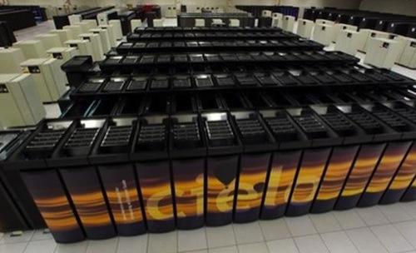
Resource Management
Notes:
Image: http://www.paulcaheny.com/wp-content/uploads/2012/03/Cielo-Cray-XE6-Fastest-Linux-Supercomputers.jpg

Slide 15
Resource Management
Introduction
How do you manage user access?
How do you utilize all resources all of the time?
How do you deal with broken nodes?
How do you run high-priority jobs first?

Slide 16
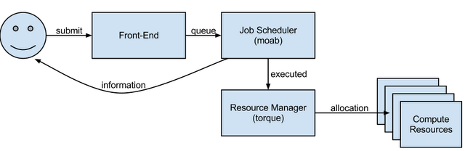
Resource Management
Overview

Slide 17
Resource Management
Job Submission
Submit job execution ('batch') script which
then executes MPI job on each node
is responsible for setting up logging
can perform more than just one thing
`msub` for Moab job submission
`msub -I` for interactive session
Some systems have quirks
Cielo has internal 'login' nodes in between the compute and front-end nodes.

Slide 18
Resource Management
Job Scheduling
Attempts to prioritize and execute jobs such that the maximum number of resources are utilized
Jobs are submitted into a queue
jobs are executed when resources are available
jobs can be assigned a priority
subject to security and political policies
Notes:
Anecdote: Good explanation would be factory workstations and limited resource scheduling with bottlenecks.

Slide 19
Resource Management
Moab Scheduler
Moab Cluster Suite
many tools and parts
produced by Adaptive Computing
based on Maui (open source)
Manages cluster workload through
job scheduling
usage monitoring and reporting
Allows for policy-based job scheduling

Slide 20
Resource Management
TORQUE Resource Manager
Terascale Open-source Resource and QUEue manager
Features:
fault tolerance and reporting
scheduler interface
integrates with Moab and Maui
large-scale management
very high processor-count machines
"tens of thousands of nodes"
high processor-count jobs
lots of logging abilities

Slide 21
Summary

Slide 22
Summary
Overview
Account Management
File System
Resource Management

Slide 23
Questions

Slide 24
Quiz

